Slide 1
Final Topics: Bridging, Account Abstraction, and DAOs
CS251 Fall 2023
(cs251.stanford.edu)
Dan Boneh
Invited talk final lecture. Final exam next Wednesday.

Slide 2
Many more topics to cover …
Blockchain interoperability (bridging)
Account abstraction
Governance: How to decide on updates to, say, Compound?
Re-staking: using your stake to secure multiple applications
Shared sequencing: sequencing Tx for multiple L2s at once
Embedded wallets: simplifying the user experience
Many more cryptography techniques (see slides at end)

Slide 3
More topics …
Where can I learn more?
CS255 and CS355: Cryptography (Winter and Spring)
EE374: Scaling blockchains with fast consensus
Science of blockchain conference (SBC): Aug. 2024.
Stanford blockchain club
A career in blockchains? Where to start? [link]

Slide 4
Interoperability between blockchain
How to bridge chains

Slide 5
Many L1 blockchains
Bitcoin: Bitcoin scripting language (with Taproot)
Ethereum: EVM. Currently: high Tx fees (better with Rollups)
EVM compatible blockchains: Celo, Avalanche, BSC, …
Higher Tx rate ⟹ lower Tx fees
EVM compatibility ⟹ easy project migration and user support
Other fast non-EVM blockchains: Solana, Flow, Algorand, …
Higher Tx rate ⟹ lower Tx fees
Notes:
User support on EVM-compatible chains: just use metamask by telling it to use a different network.

Slide 6
The problem: siloes
Flow
Cosmos
Ethereum
Osmosis DEX
Can I use Osmosis??
Bitcoin
Polkadot
How???
20 DOT
Notes:
Much like networking before the Internet

Slide 7
Interoperability
Interoperability:
User owns funds or assets (NFTs) on one blockchain system Goal: enable user to move assets to another chain
Composability:
Enable a DAPP on one chain to call a DAPP on another
Both are easy if the entire world used Ethereum
In reality: many blockchain systems that need to interoperate
The solution: bridges

Slide 8
A first example: BTC in Ethereum
How to move BTC to Ethereum ?? Goal: enable BTC in DeFi.
⟹ need new ERC20 on Ethereum pegged to BTC
(e.g., use it for providing liquidity in DeFi projects)
The solution: wrapped coins
Asset X on one chain appear as wrapped-X on another chain
For BTC: several solutions (e.g., wBTC, tBTC, …)

Slide 9
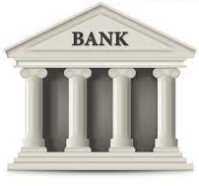
wBTC and tBTC: a lock-and-mint bridge
Let’s start with wBTC: moving 1 BTC to Ethereum
Alice on
Ethereum
Alice
1₿ verified
(signed)
1 ₿
mint 1 wBTC
credit Alice’s address
ERC20
1 ₿
1 ₿
custodian’s BTC address
bridge contract
1 wBTC
(lock 1 BTC)
to use in DeFi
(watch for deposits)
custodian

Slide 10
Alice wants her 1 BTC back
Moving 1 wBTC back to the Bitcoin network:
deduct 1 wBTC from Alice
Alice on
Ethereum
Alice
Bitcoin Tx
(signed)
1 ₿
burn my 1 wBTC
(signed)
1 ₿
1 ₿
custodian’s BTC address
bridge contract
(1 BTC unlocked)
(watch for burns)
custodian

Slide 11
wBTC
Example BTC ⇾ Ethereum:
(Bitcoin Tx: ≈4,000 BTC)
(Ethereum Tx: )
Why two hours?
… make sure no Bitcoin re-org
The problem: trusted custodian
Can we do better?
Notes:
Custodian can run away with BTC, or require high redemption fees.

Slide 12
tBTC: no single point of trust
Alice requests to mint tBTC:
random three registered custodians are selected and they generate P2PKH Bitcoin address for Alice
signing key is 3-out-of-3 secret shared among three
(all three must cooperate to sign a Tx)
Alice sends BTC to P2PKH address, and received tBTC.
Custodians must lock 1.5x ETH stake for the BTC they manage
If locked BTC is lost, Alice can claim staked ETH on Ethereum.
Notes:
P2PKH: pay to public key hash.
3-out-of-3 threshold ECDSA: ensures no single party can steal UTXO deposit.
Not capital efficient.

Slide 13
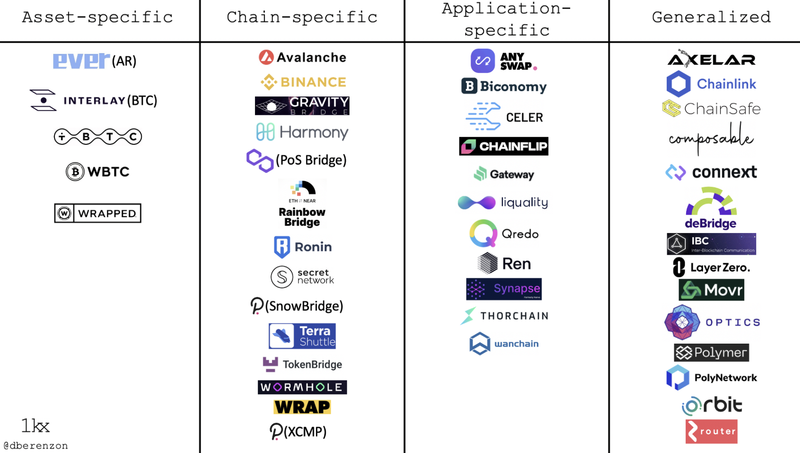
Bridging smart chains (with Dapp support)
A very active area:
Many super interesting ideas
https://medium.com/1kxnetwork/blockchain-bridges-5db6afac44f8

Slide 14
Two types of bridges
Type 1: a lock-and-mint bridge
SRC ⇾ DEST: user locks funds on SRC side, wrapped tokens are minted on the DEST side
DEST ⇾ SRC: funds are burned on the DEST side, and released from lock on the SRC Side
Type 2: a liquidity pool bridge
Liquidity providers provide liquidity on both sides
SRC ⇾ DEST: user sends funds on SRC side, equivalent amount released from pool on DEST side

Slide 15
Bridging smart chains (with Dapp support)
Step 1 (hard): a secure cross-chain messaging system
message to Y
on chain T: data
Source Chain S
DAPP-X
relayer
(contract)
I believe it
message from X
on chain S: data
Target Chain T
DAPP-Y
relayer
(contract)
Step 2 (easier): build a bridge using messaging system

Slide 16
Bridging smart chains (with Dapp support)
Step 1 (hard): a secure cross-chain messaging system
Source Chain S
Target Chain T
DAPP-X
DAPP-Y
Step 2 (easier): build a bridge using messaging system
DAPP-X ⇾ DAPP-Y: “I received 3 CELO, ok to mint 3 wCELO”
DAPP-Y ⇾ DAPP-X: “I burned 3 wCELO, ok to release 3 CELO”
If messaging system is secure, no one can steal locked funds at S
Notes:
… or “I received CryptoPunk#6587, ok to let Alice use it as collateral on chain T”

Slide 17
Primarily two types of messaging systems
(1) Externally verified: external parties verify message on chain S
verify sig and dispatch to recipients
collect msgs D[]
Relayer on S received messages D[] (signed)
Source Chain S
Target Chain T
relayerS
relayerT
Trustees (watch relayerS)
RelayerT dispatches only if all trustees signed
⟹ if DAPP-Y trusts trustees, it knows DAPP-X sent message
Notes:
This is a simplified version of Celo Optics. Same with Wormhole: 2/3 of guardians need to sign.

Slide 18
Primarily two types of messaging systems
(1) Externally verified: external parties verify message on chain S
verify sig and dispatch to recipients
collect msgs D[]
Relayer on S received messages D[] (signed)
Source Chain S
Target Chain T
relayerS
relayerT
Trustees (watch relayerS)
What if trustees sign and post a fake message to relayerT?
anyone can send trustee’s signature to relayerS ⟹ trustee slashed on S
Notes:
What about replay attacks? Can also handle trustees that double-post a message to relayerT.

Slide 19
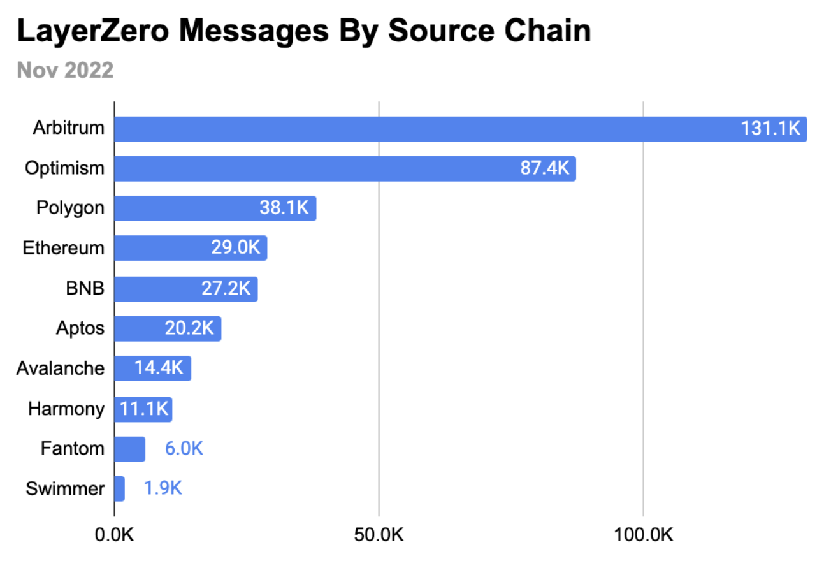
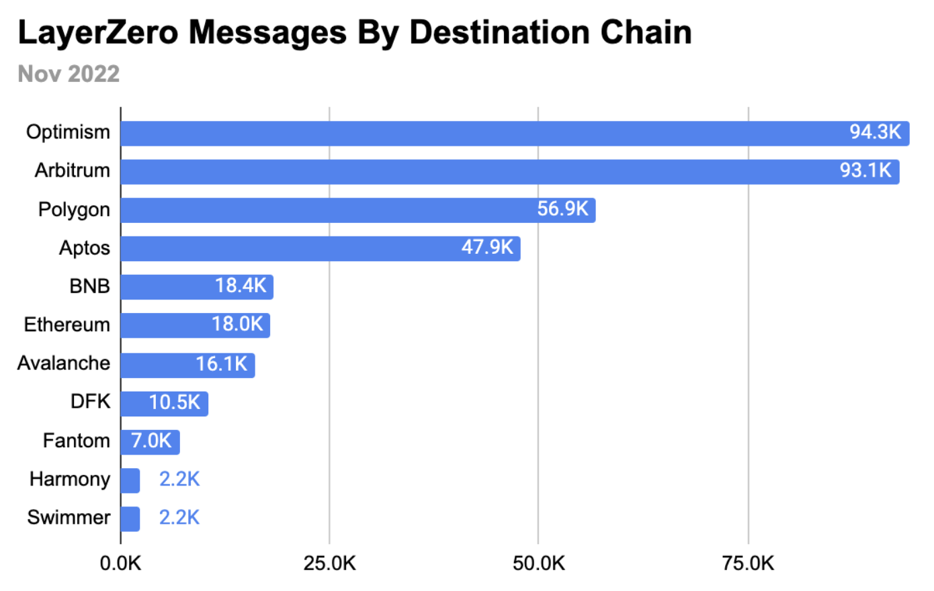
Activity

Slide 20
Primarily two types of messaging systems
(2) On-chain verified: chain T verifies block header of chain S
send messages D[] to relayerT,
along with finalized block header on chain S,
and consensus data
verify and dispatch
receive msgs
Source Chain S
Target Chain T
relayerS
relayerT
oracle
no trustees
relayerT runs a light-client for chain S to verify that relayerS received messages D[]
assumes security of light client
Notes:
Oracle is not really trusted because it is only relaying *finalized* blocks.

Slide 21
Primarily two types of messaging systems
SNARK prover
(proof of state on chain S)
verify SNARK proof and dispatch
msgs D[]
receive msgs
D[], BH, proof
Source Chain S
Target Chain T
relayerS
relayerT
chain S block header (BH) and consensus data
oracle
Problem: high gas costs on chain T to verify state of source chain S.
Solution: zkBridge: use SNARK to reduce work for relayerT
Notes:
Oracle is not really trusted because it is only relaying *finalized* blocks.

Slide 22
Primarily two types of messaging systems
SNARK prover
(proof of state on chain S)
verify SNARK proof and dispatch
msgs D[]
receive msgs
D[], BH, proof
Source Chain S
Target Chain T
relayerS
relayerT
chain S block header (BH) and consensus data
oracle
… being built by Succinct Labs
Notes:
Third type of messaging system: optimistic bridges (using fraud proofs) as implemented by Nomad.

Slide 23
Bridging: the future vision
User can hold assets on any chain
Assets move cheaply and quickly from chain to chain
A project’s liquidity is available on all chains
Users and projects choose the chain that is best suited for their application and asset type
We are not there yet …

Slide 24
Account abstraction
… as designed in ERC-4337

Slide 25
The Goals of Account Abstraction (AA)
Recall: an asset held in an Externally Owned Account (EOA) is completely controlled by the EOA’s signing key
What if I want two keys to control the asset? Or rate limits? …
Two primary goals for AA:
Goal 1: arbitrary complex policies for controlling an asset
Goal 2: a 3rd party (bundler, paymaster) pays Tx gas for users
⇒ improves user experience – no need to get ETH
⇒ asset canot be held by an EOA

Slide 26
Assets are held by a smart contract wallet
on chain
dApp
off chain
on chain
pays gas
Tx
Alice’s assets: X, Y, Z
call
Uniswap
UserOp
Alice
Bundler
(relay)
contract Wallet {
function execOp(
UserOperation op);
}
UserOperation:
address sender,
bytes callData, // args for dApp
bytes signature,
bytes nonce, // anti-replay
…
smart contract wallet (sender)

Slide 27
Smart contract wallet
on chain
dApp
off chain
on chain
pays gas
Tx
assets: X, Y, Z
call
Uniswap
UserOp
Alice
Bundler
(relay)
contract Wallet {
function execOp(
UserOperation op);
}
Problems:
How to reimburse the bundler for the gas it paid?
Bundler doesn’t want to call (potentially malicious) wallet code
UserOperation:
address sender,
bytes callData, // args for dApp
bytes signature,
bytes nonce, // anti-replay
…
smart contract wallet (sender)

Slide 28
The EntryPoint trusted contract
off chain
on chain
deposit
max gas fees
assets: X, Y, Z
Tx
UserOp
call
UserOp
Alice
contract Wallet {
function execOp(
UserOperation op);
}
gas
fees
execOp
UserOp
Bundler
(relay)
EntryPoint
contract
smart contract wallet (sender)
0x5FF137D4b0FDCD49 …
Notes:
The Bundler does not want to call untrusted code. Instead, it calls the trusted EntryPoint contract.
EntryPoint contract lives at 0x5FF137D4b0FDCD49DcA30c7CF57E578a026d2789

Slide 29
The EntryPoint trusted contract
off chain
on chain
deposit
max gas fees
assets: X, Y, Z
Tx
UserOp
call
UserOp
Alice
contract Wallet {
function execOp(
UserOperation op);
}
gas
fees
execOp
UserOp
Bundler
(relay)
More problems:
DoS: Anyone can issue invalid UserOp (e.g., with a bad sig) to EntryPoint, causing Wallet to keep paying gas to bundler.
EntryPoint
contract
smart contract wallet (sender)
0x5FF137D4b0FDCD49 …
Notes:
The Bundler does not want to call untrusted code. Instead, it calls the trusted EntryPoint contract.
EntryPoint contract lives at 0x5FF137D4b0FDCD49DcA30c7CF57E578a026d2789

Slide 30
Solution: validateOp
off chain
on chain
deposit
max gas fees
Tx
assets: X, Y, Z
UserOp
call
UserOp
Alice
validateOp
UserOp
contract Wallet {
function ValidateOp(
UserOperation op);
function execOp(
UserOperation op);
}
gas
fees
Bundler
(relay)
execOp
UserOp
EntryPoint
contract
smart contract wallet (sender)
Notes:
The Bundler does not want to call untrusted code. Instead, it calls the trusted EntryPoint contract.
EntryPoint contract lives at 0x5FF137D4b0FDCD49DcA30c7CF57E578a026d2789

Slide 31
Solution: validateOp
off chain
on chain
deposit
max gas fees
Tx
assets: X, Y, Z
UserOp
call
UserOp
Alice
validateOp
UserOp
contract Wallet {
function ValidateOp(
UserOperation op);
function execOp(
UserOperation op);
}
gas
fees
Bundler
(relay)
EntryPoint steps: (simplified)
step 1: call validateOp(UserOp)
step 2: if fail, stop and Bundler pays the gas
step 3: call ExecOp(UserOp), and Wallet reimburses Bundler for gas
execOp
UserOp
EntryPoint
contract
smart contract wallet (sender)
Notes:
The Bundler does not want to call untrusted code. Instead, it calls the trusted EntryPoint contract.
EntryPoint contract lives at 0x5FF137D4b0FDCD49DcA30c7CF57E578a026d2789

Slide 32
More problems …
1. Need to ensure that Wallet does not execute op in validateOp
⇒ Bundler will be stuck with execution fees
2. Before issuing Tx, Bundler needs to run validateOp in its head (a.k.a simulates validateOp) to ensure that UserOp is valid
⇒ need to ensure that simulation and on-chain execution of validateOp produce the same output
Solution: validateOp is restricted in what EVM opcodes it can use
[execOp is not restricted because Wallet is paying gas fees]
Notes:
The reason for (2): without simulation, Bundler might submit an invalid UserOp and get stuck with gas fees.
A malicious validateOp could use TIMESTAMP or BLOCKHASH to behave differently in simulation and during real on-chain execution.
validateOp can only access its own Wallet storage, or another contract’s storage at its wallet address in an [address=>value mapping].

Slide 33
Bundling and Paymasters
off chain
on chain
Alice
Wallet
call
one Tx
UserOp
UserOps[]
Bob
Wallet
call
UserOp
gas
fees
Carol
Wallet
call
UserOp
EntryPoint
contract
Bundler
(relay)
Paymaster:
function AgreeToPay(
UserOperation op);
As usual, Users pay Bundler a fee to be placed in Tx
Notes:
Every wallet and Paymaster maintains a balance with the EntryPoint contract.
Bundler runs a mempool and sequences UserOps into a Tx. Bundless collects EIP1559 style fees, along with MEV for sequencing.

Slide 34
Very complex … is this real?
Bundler’s already exists, such as Pimlico
Simple Tx now consume a lot of gas:
Simple ETH transfer from Alice⇾Bob: 4X more expensive
ERC20 transfer from Alice⇾Bob: 2X more expensive
Recall: gas on L2 is not as expensive as gas on Ethereum
Main reason for adoption:
Can be deployed now with no changes to dApps !!

Slide 35
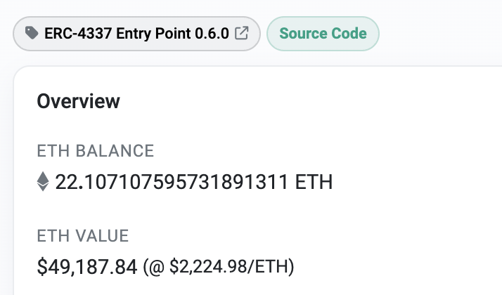
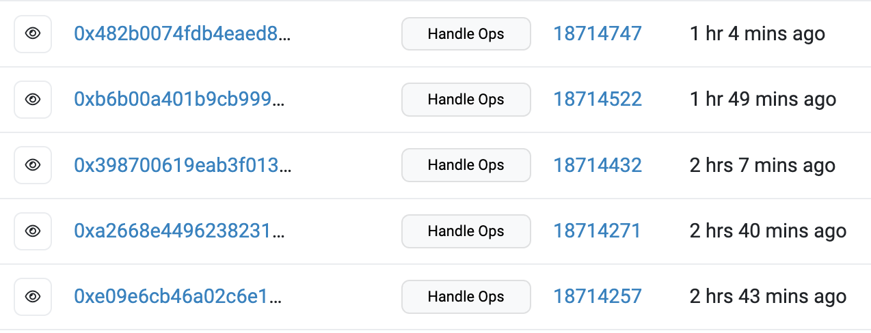
An example
The EntryPoint contract on Ethereum
Some Tx from bundlers

Slide 36
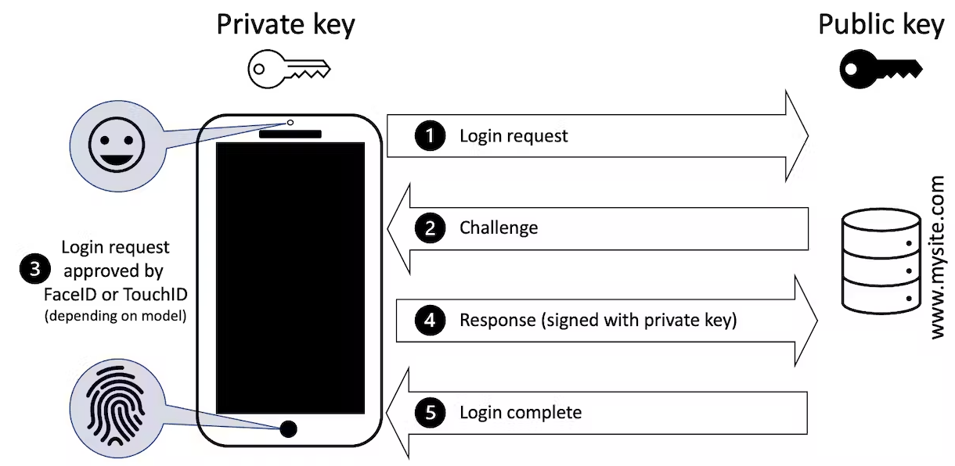
An interesting application of AA: Passkey Tx
User authenticates Tx to AA wallet using TouchID
Good user experience:
Signing key is backed up to iCloud
Signing key is available on all user devices
The challenge: Passkeys uses sig. scheme not supported in the EVM
⇒ need to use a SNARK to prove valid sig to on-chain wallet.

Slide 37
Blockchain Governance (DAOs)

Slide 38
Decentralized orgs (DAO)
What is a DAO?
A Dapp deployed on-chain at a specific address
Anyone (globally) can send funds to DAO treasury
Anyone can submit a proposal to DAO
⟹ participants vote
⟹ approved ⇾ proposal executes
snapshot.org
(SafeSnap: trustless on-chain execution of off-chain votes)
Notes:
Movie studio DAO: participants decide what movie scripts to fund, and then share in profits from movie.

Slide 39
Examples of DAOs
There are currently about 6500 DAOs managed on Snapshot
Collector DAOs: PleasrDAO, flamingoDAO, ConstitutionDAO, …
(see art collection at https://gallery.so/pleasrdao )
PleasrDAO: 103 members.
Manages a treasury, has full time employees.
Deliberations over what to acquire over telegram.

Slide 40
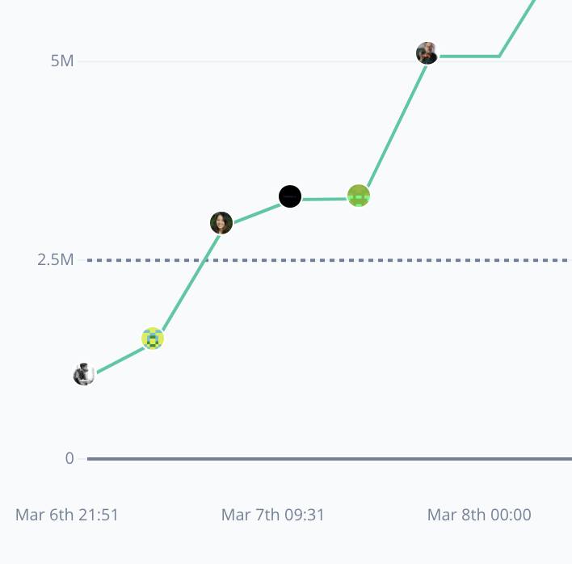
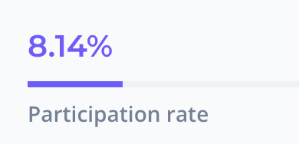
Examples of DAOs
There are currently about 6500 DAOs managed on Snapshot
Collector DAOs: PleasrDAO, flamingoDAO, ConstitutionDAO, …
Charity DAO: gitcoin (42K members), …
Proposal ID 21: This proposal looks to ratify the allocation of 30,000 GTC from the Community Treasury to the MMM workstream.
(tally.com)
Notes:
MMM: Merch Memes Marketing

Slide 41
Examples of DAOs
There are currently about 6500 DAOs managed on Snapshot
Collector DAOs: PleasrDAO, flamingoDAO, ConstitutionDAO, …
Charity DAO: gitcoin, …
Protocol DAO: manages operation of a specific protocol Uniswap DAO (29K members), Compound (4K members), …
Social DAO: FWB, …
Investment DAO: many

Slide 42
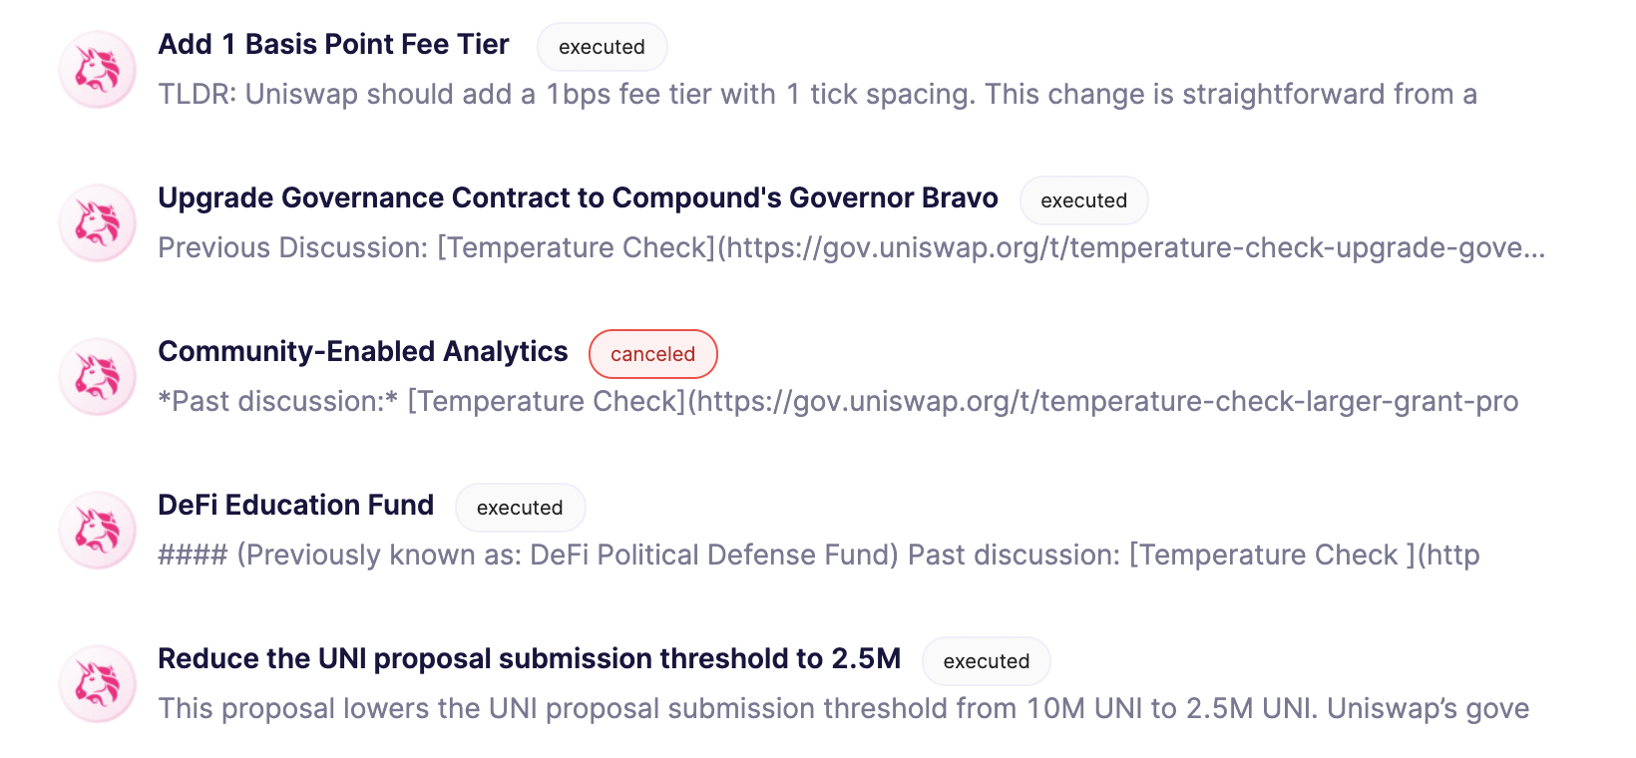
Example: Uniswap proposals

Slide 43
How to build a DAO
Three key decisions:
What is the community for the DAO?
How is membership managed?
Many available tools: Syndicate, Juicebox, Colony, …
can anyone join, or does the community vote?
How to do governance? What is controlled by governance?
Notes:
Treasury management using Gnosis.

Slide 44
Many DAO governance experiments
Who can vote? How to vote? What voting mechanism?
DAOs: a platform for experimenting with governance mechanisms

Slide 45
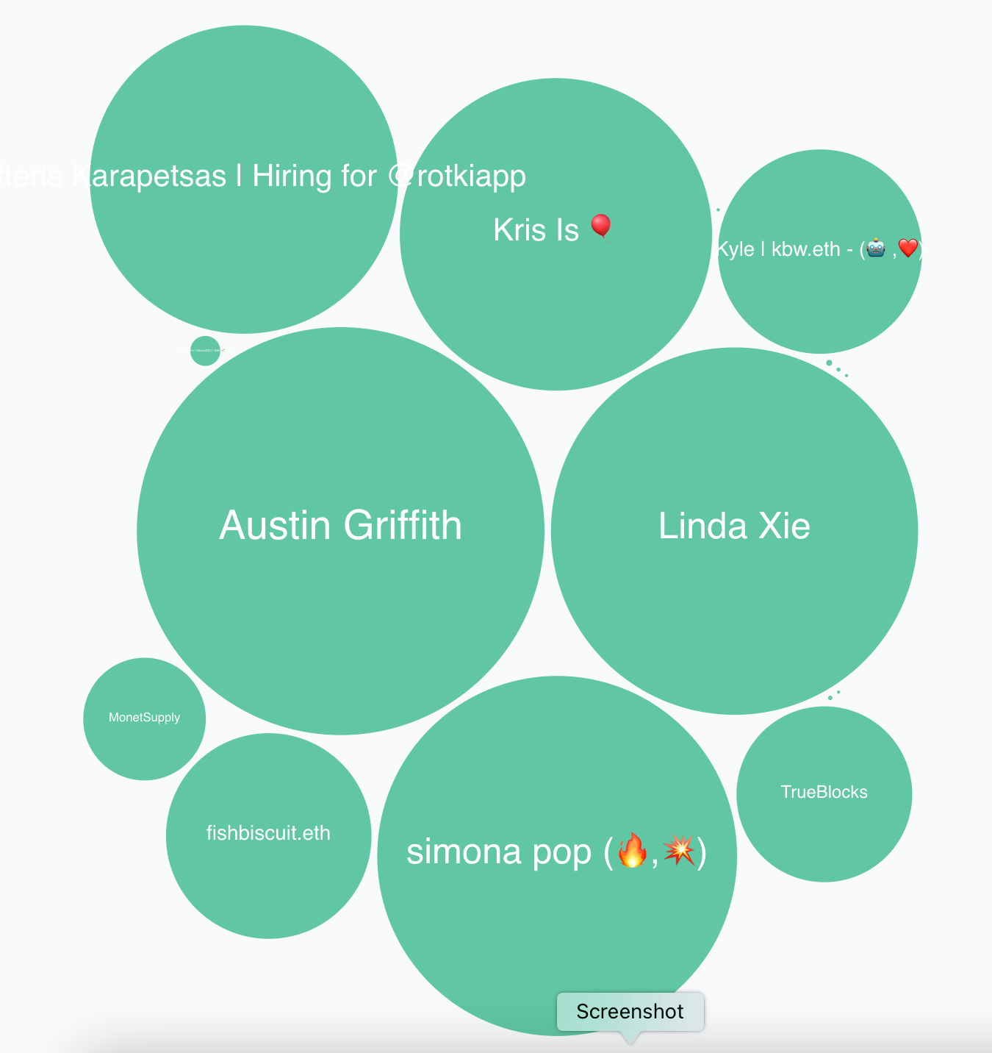
Governance methods
One token one vote: (most common)
Members receive tokens based on their contribution.
Everyone can vote.
Frequently implemented using one of OpenZeppelin’s Governor contracts (Solidity code)
_castVote( proposalID, voter, support, reason);
proposal 21 (tally.com)
Problem: direct democracy does not scale.
Notes:
https://docs.openzeppelin.com/contracts/4.x/governance

Slide 46
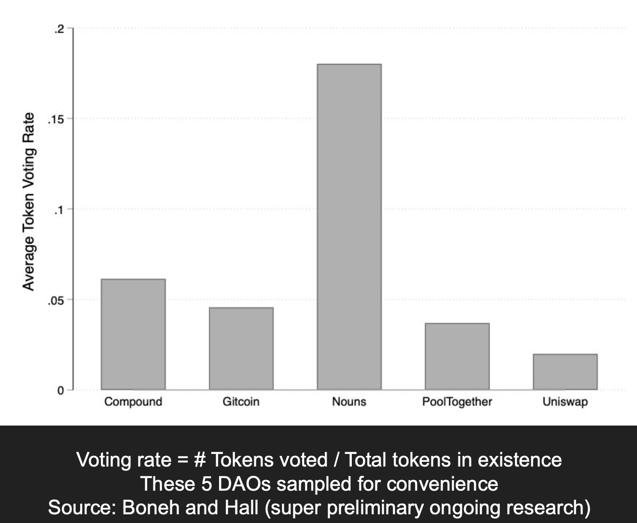
Poor participation rate
For all but one project:
participation rate < 5%
What to do? delegation
Supported in Governor contract

Slide 47
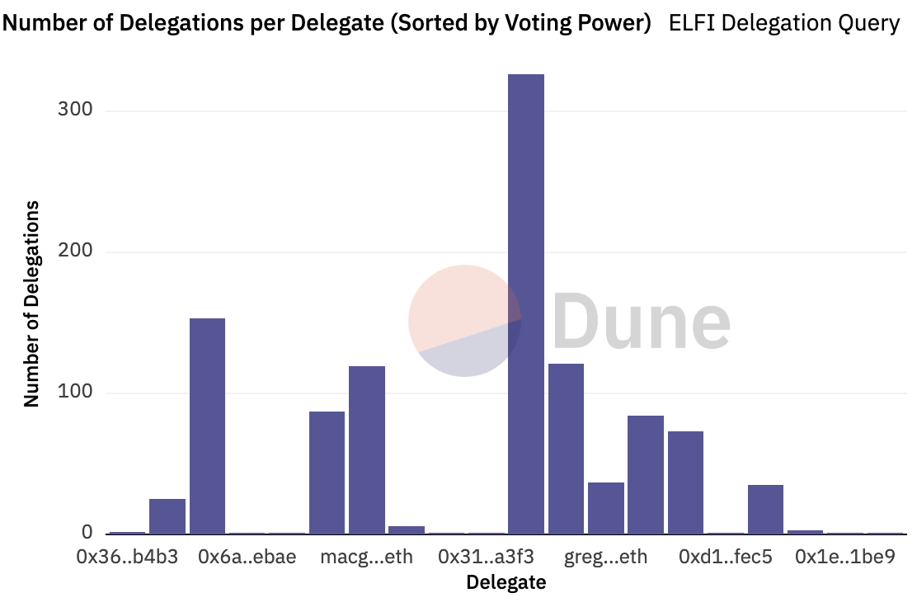
Delegation example: element
≈300 addresses delegated tokens to this address

Slide 48
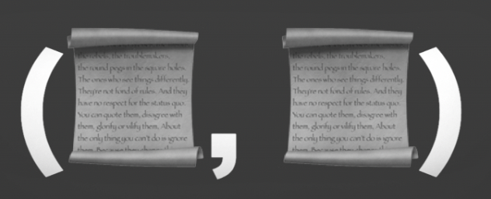
Private DAO treasury
2021: an auction for a physical copy of the constitution.
ConstitutionDAO:
Formed in Nov. 2021 to participate in auction.
Raised $46.3M from about 20K participants worldwide
Lost to another bidder who bid $43M
(Sotheby's auction house)
bidder knew that ConstitutionDAO could not outbid it
How to participate in an auction when everyone knows your treasury??

Slide 49
Private DAO treasury [Dunaif, Boneh, 2021]
The design:
One DAO platform manages many DAOs: a single Ethereum contract (e.g., JuiceBox)
DAO manager: sets up a DAO by publishing a DAO public key (pk)
Contributor: sends funds to platform with a “blinded DAO-pk”
Contract records contribution
⇒ an observer learns nothing about which DAO received the funds
⇒ only learns total amount stored on the platform as a whole
DAO manager can later use its secret key to claim funds sent to its DAO
medium.com/@boneh
Notes:
Griffin Dunaif

Slide 50
Many other DAO privacy questions …
Private DAO participation: keep participant list private
Private voting: keep who voted how on each proposal private
Private delegations
… while complying with all relevant laws.
Some of these questions are solved by general privacy platforms such as Aztec, Aleo, and others.

Slide 51
Governance failures
DAO hacks:
Attack on Beanstalk governance: $182M
Attack on Yam Finance governance: thwarted
Attack on Build Finance governance $1.5M
Attack on Mango governance: $115M
Steem governance drama
What happened? What can we learn?

Slide 52
(1) Beanstalk (Apr. 2022)
An Ethereum-based stablecoin Bean. Governance token Stalk.
The problem:
an attacker can buy Stalk tokens,
submit a proposal,
vote on proposal, and
have proposal execute
all in a single
transaction

Slide 53
Beanstalk: the attack
Review: flashloan (has many applications)
a loan that is taken out and repaid back in a single transaction
No risk to lender ⇒ unbounded amount can be borrowed
The attack:
Attacker took a huge flashloan from Aave, bought lots of Stalk,
Passed a proposal to pay $80M to the attacker from the treasury,
Sold the Stalk, and repaid the flashloan,
Sent the proceeds to Tornado cash (donated $250K to Ukraine)

Slide 54
The lesson
The protocol relaunched four months later, and is still around.
The lesson: governance requires delays
Require token holders to hold token for a long period of time
Build a delay between proposal genesis, voting, and execution

Slide 55
(2) Yam Finance (July 2022)
A DeFi project running on Ethereum. Governed token YAM.
What happened? (within a single day)
Attacker bought 224739 YAM with borrowed funds
Attacker submitted a governance proposal granting it control of project reserves ($3M USD)
Voted on proposal with borrowed 224739 YAM, hitting quorum
Borrowed YAM exchanged for Eth and paid back

Slide 56
What happened next?
Yam Finance team: noticed the proposal shortly after it hit quorum
⇒ retained cancel power, and canceled the proposal.
Lesson:
Illustrates the positive power of a veto
The problem: power can never be taken away (unless voluntarily given away)

Slide 57
END OF LECTURE
Next lecture: super cool final guest lecture
Notes:
Olaf

Slide 58
Fun crypto tricks

Slide 59
BLS signatures
one Bitcoin block
inputs
outputs
Signatures make up most of Tx data.
Can we compress signatures?
Yes: aggregation!
not possible for ECDSA
Tx1:
sig
sig
sig
Tx2:
sig
sig
sig
sig
Tx3:
sig
sig
Tx4:
sig
sig
sig

Slide 60
BLS Signatures
Used in modern blockchains: Ehtereum 2.0, Dfinity, Chia, etc.
The setup:
G = {1, g, …, g^{q-1}} a cyclic group of prime order q
H: M × G ⇾ G a hash function (e.g., based on SHA256)

Slide 61
BLS Signatures
KeyGen(): choose random $α$ in $\{1, …, q\}$
output sk = $α$ , pk = $g^{α}$ ∈ G
Sign(sk, $m$): output sig = ${H(m,pk)}^{α}$ ∈ G
Verify(pk, $m$, sig): output accept if log_{g}(pk) = log_{H(m,pk)}(sig)
Note: signature on $m$ is unique! (no malleability)

Slide 62
How does verify work?
A pairing: an efficiently computable function e:G×G ⇾ G’
such that e($g^{α},g^{β})={e(g,g)}^{αβ}$ for all $α,β∈\{1,…q\}$
and is not degenerate: $e(g, g)≠1$
Observe: log_{g}(pk) = log_{H(m,pk)}(sig)
if and only if e(g, sig) = e(pk, H(m,pk))
verify test
=
=
e(g, H(m,pk)$α$) = e(g$α$, H(m,pk))

Slide 63
Properties: signature aggregation [BGLS’03]
Anyone can compress n signatures into one
Verify( pk , m , σ* ) = “accept”
convinces verifier that for i=1,…,n: user i signed msg m_{i}
pk₁ , m₁ ⟶ σ₁
⋮
aggregate
⟶ σ*
pk_{n} , m_{n} ⟶ σ_{n}
single short signature

Slide 64
Aggregation: how
user 1: pk₁ = g^{α1} , m₁ ⟶ σ₁=H(m₁,pk₁)^{α1}
σ ⟵ σ₁⋯ σ_{n}
user n: pk_{n} = g^{αn} , m_{n} ⟶ σ_{n}=H(m_{n},pk_{n})^{αn}
Verifying an aggregate signature: (incomplete)
$\prod_{i=1}^{n}{\text{e}\text{(}\text{H}\text{(}\text{mi}\text{,}\text{pki}\text{), }\text{g}\text{α}\text{i}\text{)}}$ ≟ e(σ, g)
=
=
Π_{i=1} e(H(m_{i},pk_{i})^{αi}, g) = e(Π_{i=1}H(m_{i},pk_{i})^{αi}, g)

Slide 65
Compressing the blockchain with BLS
one Bitcoin block
if needed:
compress all signatures in a block into a single aggregate signatures
⇒ shrink block
or: aggregate in smaller batches
inputs
outputs
sig*
Tx1:
sig
sig
sig
Tx2:
sig
sig
sig
sig
Tx3:
sig
sig
Tx4:
sig
sig
sig

Slide 66
Reducing Miner State

Slide 67
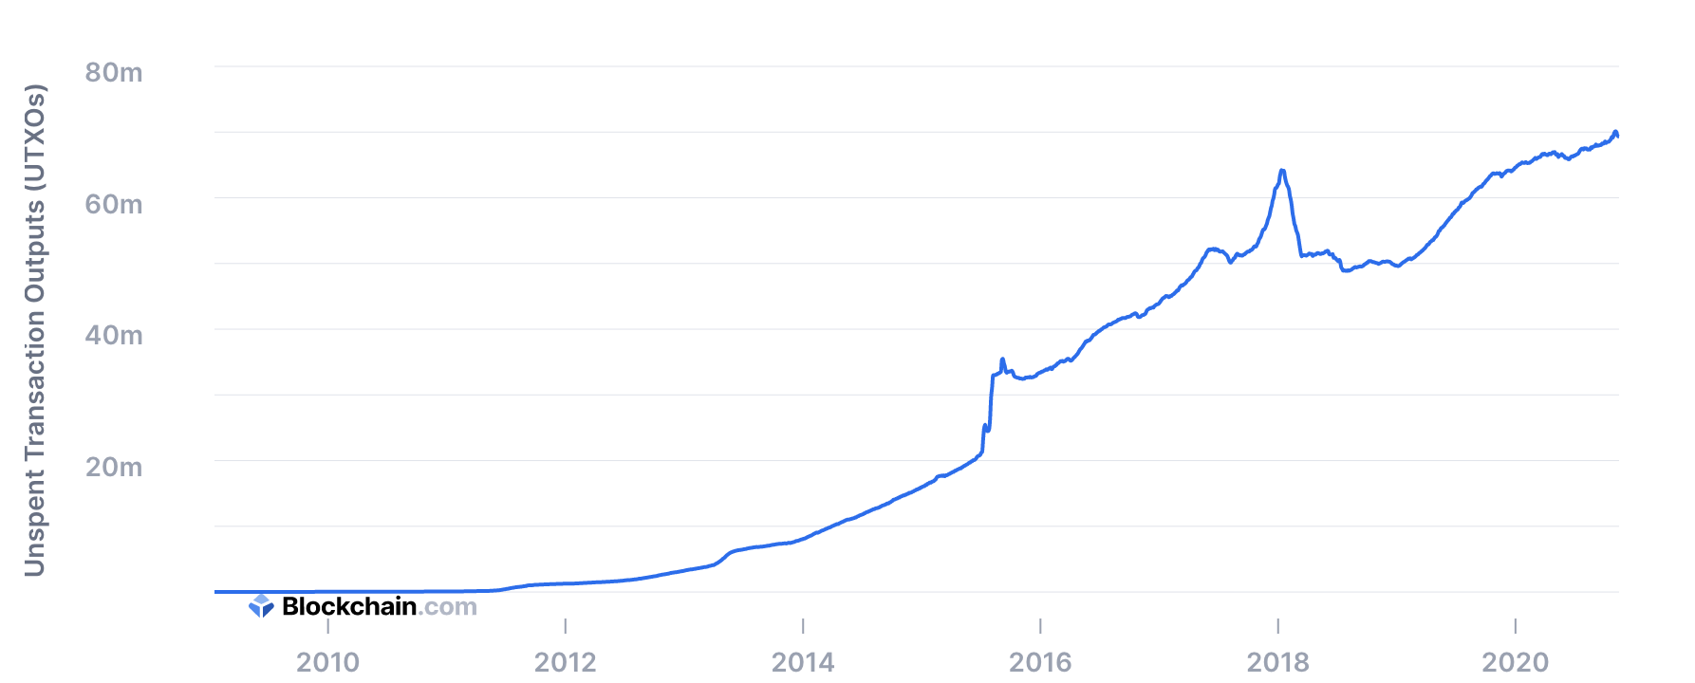
UTXO set size
≈70M UTXOs
Miners need to keep all UTXOs in memory to validate Txs
Can we do better?

Slide 68
Recall: polynomial commitments
commit(pp, f, r) ⇾ com_{f} commitment to f ∈ $𝔽_{p}^{(≤d)}\left[X\right]$
eval: goal: for a given com_{f} and x, y ∈ $𝔽_{p}$,
construct a SNARK to prove that f(x) = y.

Slide 69
Homomorphic polynomial commitment
A polynomial commitment is homomorphic if
there are efficient algorithms such that:
commit(pp, f₁, r₁) ⇾ com_{f1} commit(pp, f₂, r₂) ⇾ com_{f2}
Then:
(i) for all $a, b∈𝔽_{p}^{}$ : com_{f1} , com_{f2} ⇾ com_{a*f1+b*f2}
(ii) com_{f1} ⇾ com_{X*f1}

Slide 70
Committing to a set (of UTXOs)
(accumulator)
Let $S=\{U1, … , Un\}$ ∈ $𝔽_{p}$ be a set of UTXOs
Define: $f\left(X\right)=(X−U1) ⋯(X−Un)$ ∈ $𝔽_{p}^{(≤n)}\left[X\right]$
Set: com_{f} = commit($pp, f, r$) ⇽ short commitment to $S$
For $U$ ∈ $𝔽_{p}$ : $U$ ∈ $S$ if and only if $f(U)=0$
To add U to S: com_{f} ⇾ com_{X*f−U*f} ⇽ short commitment to $S∪\{U\}$

Slide 71
How does this help?
Miners maintain two commitments:
(i) commitment to set T of all UTXOs
(ii) commitment to set S of spent TXOs
≤ 1KB
com_{T}, com_{S}
Tx format:
every input $U$ includes a proof ($U∈T$ && $U∉S$)
Two eval proofs: $T(U)=0$ && $S(U)≠0$ (short)
Tx processing: miners check eval proofs, and if valid,
add inputs to set S and outputs to set T. That’s it!

Slide 72
Does this work ??
Problem: how does a user prove that her UTXO $U$ satisfies
$T(U)=0$ && $S(U)≠0$ ???
This requires knowledge of the entire blockchain
⇒ user needs large memory and compute time
⇒ … can be outsourced to an untrusted 3rd party
UTXO $U$ , fee
polynomials
S and T
proof $π$
spend $U$
The proof factory

Slide 73
Is this practical?
Not quite …
Problem: the factory’s work per proof is linear in the number of UTXOs ever created
Many variations on this design:
can reduce factory’s work to log₂(# current UTXOs) per proof
Factory’s memory is linear in (# current UTXOs)
End result: outsource memory requirements to a small number of 3rd party service providers
Notes:
factory work is logarithmic by using 2-3 trees.

Slide 74
Taproot: semi-private scripts in Bitcoin

Slide 75
Taproot is here …

Slide 76
Script privacy
Currently: Bitcoin scripts must be fully revealed in spending Tx
Can we keep the script secret?
Answer: Yes, easily! when all goes well …

Slide 77
How?
ECDSA and Schnorr public keys:
KeyGen(): sk = $α$ , pk = $g^{α}$ ∈ G for $α$ in $\{1, …, q\}$
Suppose sk_{A} = $α$ , sk_{B} = $β$.
Alice and Bob can sign with respect to pk $={pk}_{A}∙{pk}_{B}=g^{α+β}$
⇒ an interactive protocol between Alice and Bob
(note: much simpler with BLS)
⇒ Alice & Bob can imply consent to Tx by signing with pk = $g^{α+β}$

Slide 78
How?
S: Bitcoin script that must be satisfied to spend a UTXO $U$
S involves only Alice and Bob. Let ${pk}_{AB}={pk}_{A}∙{pk}_{B}$
Goal: keep S secret when possible.
How: modify S so that a signature with respect to
pk =${pk}_{AB}∙$ $g^{H({pk}_{AB} , S)}$
is sufficient to spend UTXO, without revealing S !!

Slide 79
The main point
If parties agree to spend UTXO,
⇒ sign with respect to ${pk}_{AB}$ and spend while keeping S secret
If disagreement, Alice can reveal S and spend UTXO by proving that she can satisfy S.
Taproot pk compactly supports both ways to spend the UTXO

