Slide 1
Scaling the blockchain part I:
Payment Channels and State Channels
CS251 Fall 2023
(cs251.stanford.edu)
Dan Boneh

Slide 2
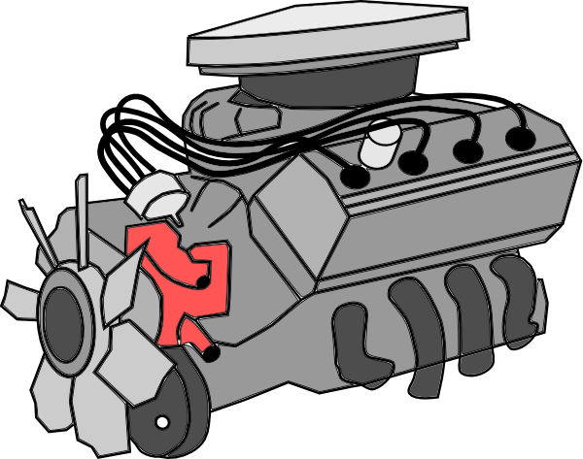
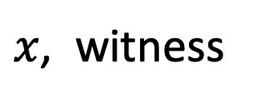

… but first, last words on SNARKs (for now)
SNARK
backend
prover
heavy
computation
DSL
program
Circom,
ZoKrates,
Leo,
Zinc,
Cairo,
Noir,
…
SNARK
friendly
format
circuit,
R1CS,
EVM code,
assembly
code,
RISC-V
compiler
(circuit)
$$π$$
…
domain
specific
language
$x$, witness

Slide 3
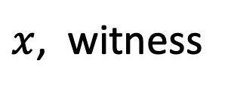
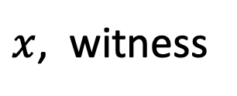
… but first, last words on SNARKs (for now)
circuit
$$π$$
$x$, witness
Polynomial
Relations
circuit
$$π$$
arithmetization
$x$, witness
proves
polynomial
relations

Slide 4
Scaling the blockchain

Slide 5
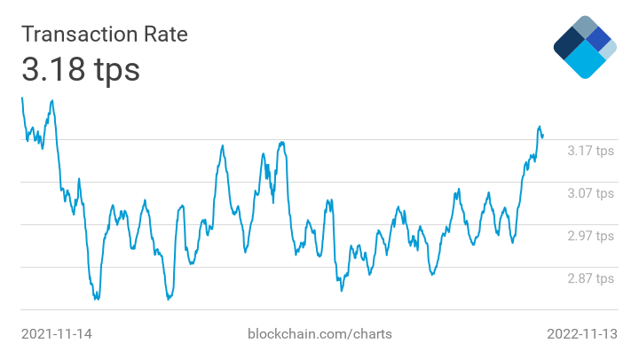
Bitcoin Tx per second
≈4200 Tx/block
1 block / 10 mins
⇒ max: 7 Tx/sec
Notes:
https://www.blockchain.com/explorer/charts/transactions-per-second

Slide 6
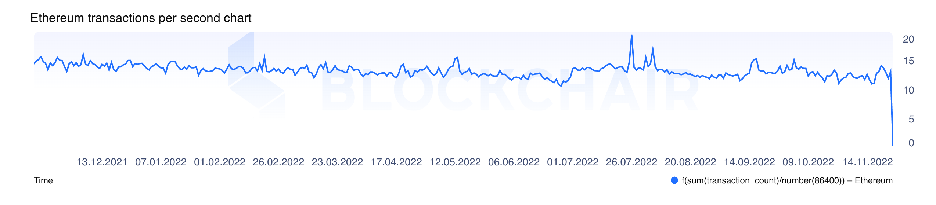
Ethereum Tx per second
Ethereum avg Tx per second:
Simple Tx: 21k Gas
max 30M Gas per block
⇒ max 1428 tx/block
1 Block/12s
⇒ max 119 tx/s
≈ 15 Tx/sec
Notes:
https://blockchair.com/ethereum/charts/transactions-per-second

Slide 7
In comparison …
Visa: up to 24,000 Tx/sec (regularly 2,000 Tx/sec)
PayPal: 200 Tx/sec
Ethereum: 15 Tx/sec
Bitcoin: 7 Tx/sec
Goal: scale up blockchain Tx speed

Slide 8
How to process more Tx per second
Many ideas:
Use a faster consensus protocol
Parallelize: split the chain into independent shards
Rollup: move work somewhere else (next lecture)
Today: payment channels, reduce the need to touch the chain
reduced
composability

Slide 9
Payment Channels: the basic idea
Tx fee
per purchase!
Tx1: 0.01 ETH
Tx2: 0.01 ETH
Tx3: 0.01 ETH
Instead can do this:
Alice deposits 1 ETH with Bob.
At the end of the month, Bob
refunds unused deposit to Alice.
☕️
only two Tx,
hundreds of
coffees
☕️
☕️

Slide 10
Unidirectional Payment Channel
Alice
creates:
Contract A:
1 ETH
Bob does not post on chain
Post Tx3 on
Blockchain
(close channel)
Tx1: send 0.99 to Alice / 0.01 to Bob from Contract A
signed by Alice
Tx2: send 0.98 to Alice / 0.02 to Bob from Contract A
signed by Alice
Tx3: send 0.97 to Alice / 0.03 to Bob from Contract A
signed by Alice
Problem: Alice could post Tx1 before Bob even though she bought three coffees.

Slide 11
A solution?
Alice
creates:
Contract A:
1 ETH
Only Bob can close the channel
Post Tx3 on
Blockchain
(close channel)
Tx1: send 0.99 to Alice / 0.01 to Bob from Contract A
signed by Alice
Tx2: send 0.98 to Alice / 0.02 to Bob from Contract A
signed by Alice
Tx3: send 0.97 to Alice / 0.03 to Bob from Contract A
signed by Alice
Problem: What if Bob never publishes Tx3?
⇒ Alice never gets her 0.97 ETH back !!

Slide 12
Unidirectional Payment Channel
Alice needs a way to ensure refund if Bob disappears
Solution: create a channel that can be closed in one of two ways
Normal close Tx: Sends 0.97 to Alice / 0.03 to Bob
… requires signatures by both Alice and Bob.
Timelock Tx: Sends 1 ETH to Alice
… requires signature by Alice,
but is accepted 7 days after channel is created

Slide 13
Unidirectional Payment Channel
After 6 days:
Bob can close channel by signing and posting Tx3.
After 7 days:
Alice can close channel using timelock Tx, gets back her 1 ETH.
Timelock period determines the lifespan of channel
Once Alice sends the full 1 ETH to Bob, the Channel is ”exhausted”

Slide 14
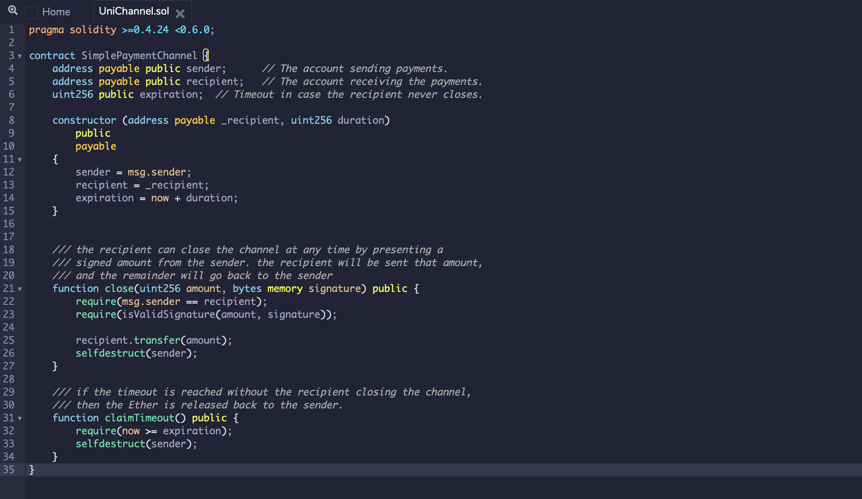
Payment Channel in Solidity
Alice creates contract with funds,
specifies timelock and recipient
verify Alice’s signature on
final amount.
Only Bob can call close() !!
send all funds to sender after timelock
Notes:
Close() can only be called by recipient; otherwise Alice could close channel in an earlier state. If amount is signed by sender then the channel is closed.

Slide 15
Bidirectional Payment Channel
Alice and Bob want to move funds back and forth
Two Unidirectional Channels?
Not as useful because Channels get exhausted

Slide 16
Bidirectional Payment Channel
On Ethereum: create a shared contract, each contributes 0.5 ETH:
channel
state:
A: 0.5 ETH, B: 0.5 ETH, Nonce=0
Off chain: Bob sends 0.1 ETH to Alice by both signing new state:
new
state:
A: 0.6, Bob: 0.4, Nonce=1
Alice sig, Bob sig

Slide 17
Bidirectional Payment Channel
On chain contract does not change:
balance: 1 ETH, Nonce=0
Off chain: Alice and Bob can move funds back and forth
by sending updated state sigs to each other:
A: 0.3, Bob: 0.7, Nonce=7
Alice sig, Bob sig
(7th transfer)

Slide 18
Eventually: Alice wants to close payment channel
Alice does: sends latest balances and signatures to contract
⇒ starts challenge period (say, 3 days)
A: 0.3 ETH, B: 0.7 ETH, Nonce=7
(pending close)
on chain:
if Bob does nothing for 3 days:
⇒ funds disbursed according to Alice’s submitted state
if Bob submits signed state with a higher nonce (e.g., nonce=9)
⇒ funds disbursed according to Bob’s submitted state

Slide 19

Watchtowers
Bidirectional channel requires Bob to constantly check that Alice did not try to close the channel with an old stale state
⇒ post latest state if she did
Watchtowers outsource this task
Trusted for availability
Bob sends latest state to watchtower.

Slide 20
Main points: summary
Payment channel between Alice and Bob:
One on-chain Tx to create channel (deposit funds);
Alice & Bob can send funds to each other off-chain
… as many Tx as they want;
One on-chain Tx to close channel and disburse funds
⇒ only two on-chain Tx

Slide 21
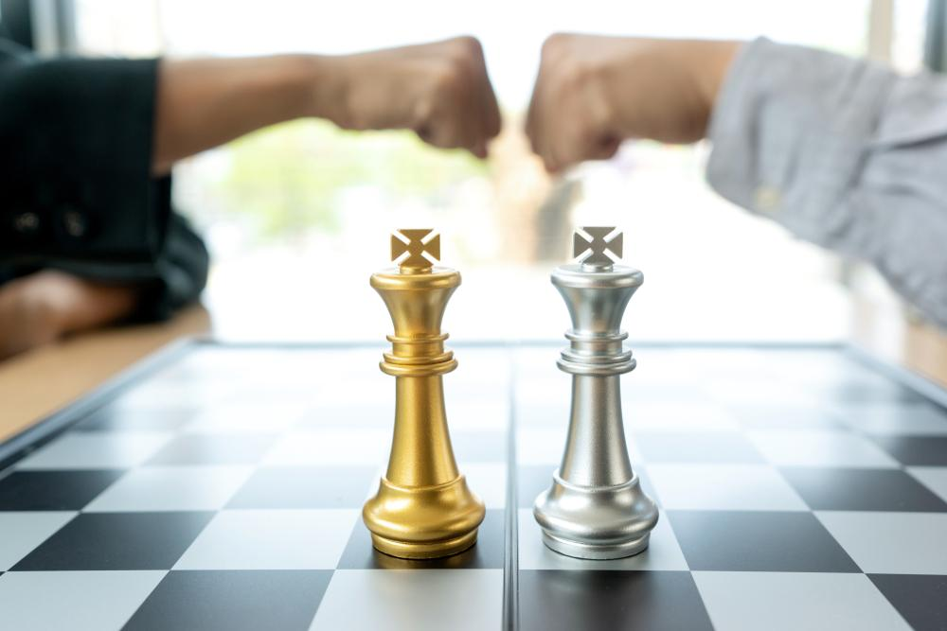
A more general concept: State Channels
Smart contract that implements a game between Alice and Bob.
Begin game & end game: on chain. All moves are done off-chain.

Slide 22
State Channels
Can be used to implement any 2-party contract off chain!
two Tx on-chain: contract creation and termination

Slide 23
Bidirectional channels on Bitcoin
The Lightning Network

Slide 24
Bidirectional payment channels on Bitcoin
Problem: no updatable state in UTXOs ⇒
much harder to implement a bidirectional channel
Solution:
When updating the channel to Alice’s benefit,
Alice gets TX that invalidates Bob’s old state

Slide 25
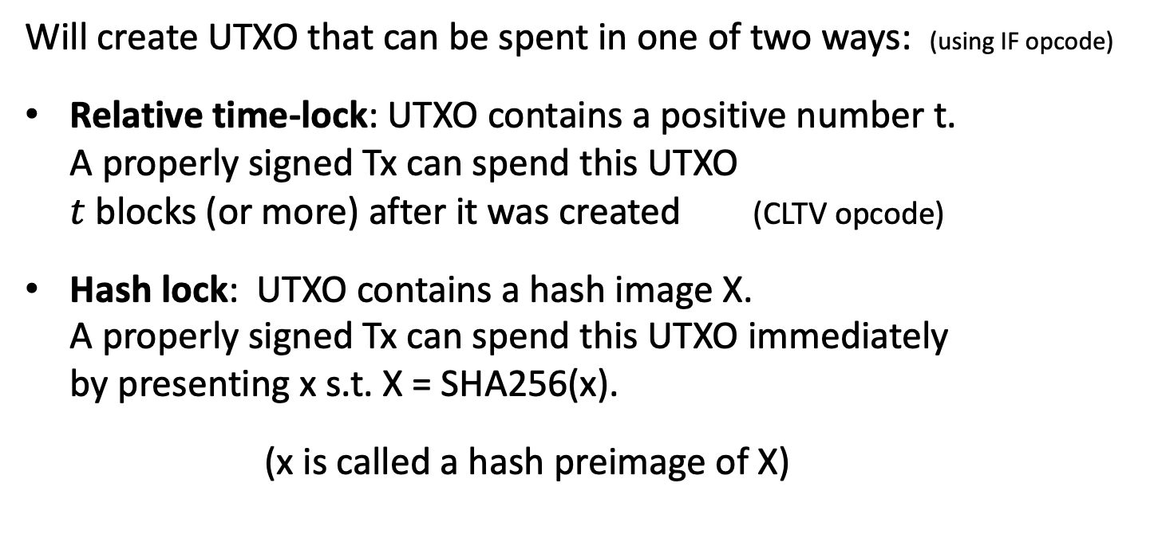
UTXO payment channel concepts
Will create UTXO that can be spent in one of two ways: (using IF opcode)
Relative time-lock: UTXO contains a positive number t.
A properly signed Tx can spend this UTXO
$t$blocks (or more) after it was created (CLTV opcode)
Hash lock: UTXO contains a hash image X.
A properly signed Tx can spend this UTXO immediately
by presenting x s.t. X = SHA256(x).
(x is called a hash preimage of X)
Notes:
Relative timelocks were introduced to Bitcoin in BIP 112. CLTV: check locktime verify

Slide 26
Example script
Example locktime redeem script: two ways to redeem UTXO
OP_IF // Alice can redeem UTXO any time using a preimage
OP_HASH256 <digest> OP_EQUALVERIFY // redeem by providing <digest> preimage,
DUP HASH256 <AlicePKhash> EQVERIFY CHECKSIG // and Alice’s signature
OP_ELSE // Bob can redeem UTXO only after timelock
<num> OP_CLTV OP_DROP // redeem <num> blocks after UTXO created,
DUP HASH256 <BobPKhash> EQVERIFY CHECKSIG // and Bob’s signature
OP_ENDIF
This is called a hash-timelock contract (HTLC).

Slide 27
UTXO Payment Channel
address AB:
2-of-2 multisig address AB
Value: 10 BTC
spending requires
sigs by Alice and Bob
7
3
X=H(x)
Y=H(y)
Random x
Random y
TX1: input: UTXO for address AB
Out1: pay 7 ⇾ A
Out2: either 3 ⇾ B, 7 day timelock
or 3 ⇾ A now, given y s.t. H(y)=Y
Alice sig
TX2: input UTXO for address AB
pay 3 -> B
either 7 ⇾ A, 7 day timelock
or 7 ⇾ B now, given x s.t. H(x)=X
Bob sig
Alice can sign and post Tx2, wait 7 days, and get her funds back
Notes:
Alice can post Tx1 and then wait 7 days and get her funds back. Same with Bob.

Slide 28
Payment Channel Update: Alice pays Bob
2-of-2 Multisig UTXO AB
Value: 10 BTC
x
☕️
X’=H(x’)
Alice sends 1BTC to Bob (off chain)
Random x’
TX3 input: UTXO for address AB
Out1: pay 6 ⇾ A
Out2: either 4 ⇾ B, 7 day timelock
or 4 ⇾ A now, given y s.t. H(y)=Y
Alice sig
TX4 input: UTXO for address AB
pay 4 ⇾ B
either 6 ⇾ A, 7 day timelock
or 6 ⇾ B now, given x’ s.t. H(x’)=X’
Bob sig
Notes:
Alice can post Tx3 and wait 7 days to get 6 BTC. However, if she posts Tx1 then Bob will use x to immediately steal the entire UTXO.

Slide 29
Security: ways to close the channel?
Alice has TX2,TX4, x, x’
Bob has TX1,TX3, y, x
TX2: (stale state)
pay 3 ⇾ B
either 7 ⇾ A, 7 day timelock
or 7 ⇾ B now, given x s.t. H(x)=X
Bob sig
TX1: (stale stale)
pay 7 ⇾ A
either 3 ⇾ B, 7 day timelock
or 3 ⇾ A now, given y s.t. H(y)=Y
Alice sig
TX4: (current state)
pay 4 ⇾ B
either 6 ⇾ A, 7 day timelock
or 6 ⇾ B now, given x’ s.t. H(x’)=X’
Bob sig
TX3: (current state)
pay 6 ⇾ A
either 4 ⇾ B, 7 day timelock
or 4 ⇾ A now, given y s.t. H(y)=Y
Alice sig

Slide 30
Security: ways to close the channel?
Alice has TX2,TX4, x, x’
Bob has TX1,TX3, y, x
TX2:
pay 3 ⇾ B
either 7 ⇾ A, 7 day timelock
or 7 ⇾ B now, given x s.t. H(x)=X
Bob sig
TX1:
pay 7 ⇾ A
either 3 ⇾ B, 7 day timelock
or 3 ⇾ A now, given y s.t. H(y)=Y
Alice sig
The good case:
Alice can post Tx4 or Bob can post Tx3 to chain and
close channel after 7 days
A gets 6, B gets 4
TX4: (current state)
pay 4 ⇾ B
either 6 ⇾ A, 7 day timelock
or 6 ⇾ B now, given x’ s.t. H(x’)=X’
Bob sig
TX3: (current state)
pay 6 ⇾ A
either 4 ⇾ B, 7 day timelock
or 4 ⇾ A now, given y s.t. H(y)=Y
Alice sig

Slide 31
Security: ways to close the channel?
Alice has TX2,TX4, x, x’
Bob has TX1,TX3, y, x
TX2: (stale state)
pay 3 ⇾ B
either 7 ⇾ A, 7 day timelock
or 7 ⇾ B now, given x s.t. H(x)=X
Bob sig
TX1: (stale state)
pay 7 ⇾ A
either 3 ⇾ B, 7 day timelock
or 3 ⇾ A now, given y s.t. H(y)=Y
Alice sig
TX4:
pay 4 ⇾ B
either 6 ⇾ A, 7 day timelock
or 6 ⇾ B now, given x’ s.t. H(x’)=X’
Bob sig
TX3:
pay 6 ⇾ A
either 4 ⇾ B, 7 day timelock
or 4 ⇾ A now, given y s.t. H(y)=Y
Alice sig
The bad case (Alice cheats):
if Alice posts the stale Tx2 then Bob will use x to take all 10 BTC
⇒ sending x to Bob revokes the stale Tx2 held by Alice
Notes:
Note: Bob has to constantly monitor blockchain to see if Alice posts a stale state. In practice this is done by the watchtower.

Slide 32
Payment Channel Update: Bob pays Alice
2-of-2 Multisig Address C:
Value: 10 BTC
y
Y’=H(y’)
Bob sends 2BTC to Alice (off chain)
Random y’
TX5 input: UTXO for address AB
pay 8 ⇾ A
either 2 ⇾ B, 7 day timelock
or 2 ⇾ A now, given y s.t. H(y’)=Y’
Alice sig
TX6 input: UTXO for address AB
pay 2 ⇾ B
either 8 ⇾ A, 7 day timelock
or 8 ⇾ B now, given x s.t. H(x’)=X’
Bob sig

Slide 33
Security: ways to close the channel?
Alice has TX2,TX6, x, x’, y
Bob has TX3,TX5, y, y’, x
TX2:
pay 3 ⇾ B
either 7 ⇾ A, 7 day timelock
or 7 ⇾ B now, given x s.t. H(x)=X
Bob sig
TX3:
pay 6 ⇾ A
either 4 ⇾ B, 7 day timelock
or 4 ⇾ A now, given y s.t. H(y)=Y
Alice sig
TX6:
pay 2 ⇾ B
either 8 ⇾ A, 7 day timelock
or 8 ⇾ B now, given x s.t. H(x’)=X’
Bob sig
TX5:
pay 8 ⇾ A
either 2 ⇾ B, 7 day timelock
or 2 ⇾ A now, given y s.t. H(y’)=Y’
Alice sig

Slide 34
Security: ways to close the channel?
Alice has TX2,TX6, x, x’, y
Bob has TX3,TX5, y, y’, x
TX2:
pay 3 ⇾ B
either 7 ⇾ A, 7 day timelock
or 7 ⇾ B now, given x s.t. H(x)=X
Bob sig
TX3:
pay 6 ⇾ A
either 4 ⇾ B, 7 day timelock
or 4 ⇾ A now, given y s.t. H(y)=Y
Alice sig
TX6:
pay 2 ⇾ B
either 8 ⇾ A, 7 day timelock
or 8 ⇾ B now, given x s.t. H(x’)=X’
Bob sig
TX5:
pay 8 ⇾ A
either 2 ⇾ B, 7 day timelock
or 2 ⇾ A now, given y s.t. H(y’)=Y’
Alice sig
The bad case (Bob cheats):
Bob posts the stale Tx3 ⇒ Alice will use y to take all 10 BTC

Slide 35
Watchtowers again
Bidirectional channel requires Bob to constantly check that Alice did not try to close the channel with an old stale state
⇒ use hashlock value if she did
Trusted for availability
Bob needs to always send latest hashlock value to watchtower.

Slide 36
Multihop payments

Slide 37
Multi-hop payments
Alice has channel
with bank Bob
Carol has channel
with bank Bob
Alice wants to pay Carol 1 BTC through untrusted intermediary Bob
How: (i) Alice pays Bob 1.01 BTC, (ii) Bob pays Carol 1 BTC
The challenge: steps (i) and (ii) need to be atomic

Slide 38
Multi-hop payments (briefly)
R=H(r)
A
B
C
send to B:
send to C:
Pay 1.01 BTC to B:
Hashlocked to B with R,
Timelock to A for refund
Pay 1 BTC to C:
Hashlocked to C with R,
Timelock to B for refund
Random r
Alice sig
Bob sig
C can claim 1 BTC on-chain with r
⇒ r is publicly known
Then B can claim 1.01 BTC with r
if Carol never claims, Alice & Bob get funds back after timelock
Notes:
Once C claim on chain, then r becomes public and B can claim his 1.01 BTC.

Slide 39
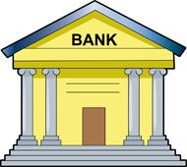
The lightning network
The network: lots of open bi-directional payment channels.
Alice wants to pay Bob: she finds a route to Bob through the graph
Many extensions possible: multi currency hubs, credit hubs, …
Notes:
Alice can pay Bob by finding a path through the network …

Slide 40
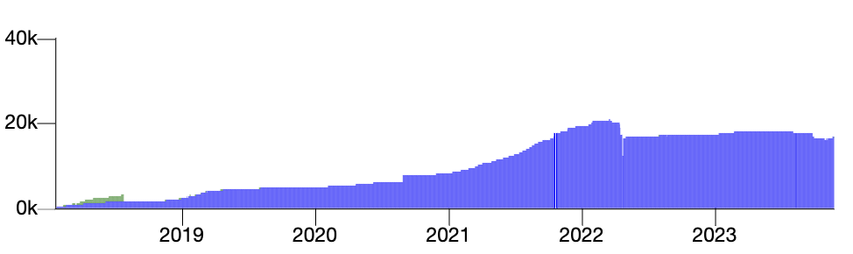
Stats
# nodes in lightning network (Nov. 2023)
16,150
Number of channels: 63K
Network capacity: ≈$205M
Notes:
https://bitcoinvisuals.com/lightning

Slide 41
END OF LECTURE
Next lecture: scaling via Rollups

